Slide 1
Fun with {ggplot2} (and {dplyr})
HT: Andrew Heiss

Slide 2
Coverage
Review conceptual dplyr issues w/ mutate(), group_by(), and ungroup()
Scales
Themes (and their elements)
Importing data + finding cool stuff

Slide 3
(Review) {dplyr} issues

Slide 4
Reminder about the pipe %>%
How do we think about pipes? “and then”
Take the gapminder data set, and then filter it to only 2002, and then make a new variable, log_gdpPercap, equal to the log of per-capita GDP
gapminder %>%
filter(year == 2002) %>%
mutate(log_gdpPercap = log(gdpPercap))

Slide 5
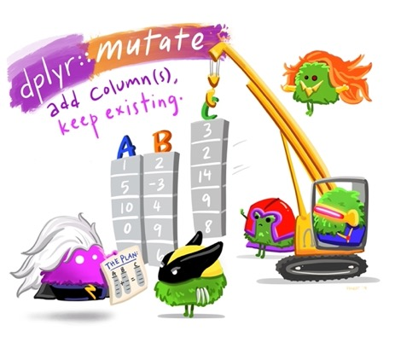
mutate()
Add a new column to your frame
You can make a bunch!
gapminder %>%
mutate(log_gdpPercap = log(gdpPercap))
gapminder %>%
mutate(gdp = gdpPercap * pop,
pop_mill = round(pop / 1000000))

Slide 6
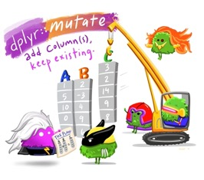
mutate()
Combines well with ifelse() statements
ifelse(TEST, VALUE_IF_TRUE, VALUE_IF_FALSE)
Create a logical variable equal to true if year > 1960
gapminder %>%
mutate(after_1960 = ifelse(year > 1960, TRUE, FALSE))
Or, make it a text variable
gapminder %>%
mutate(after_1960_v2 = ifelse(year > 1960, “After 1960”, “Before 1960”))

Slide 7
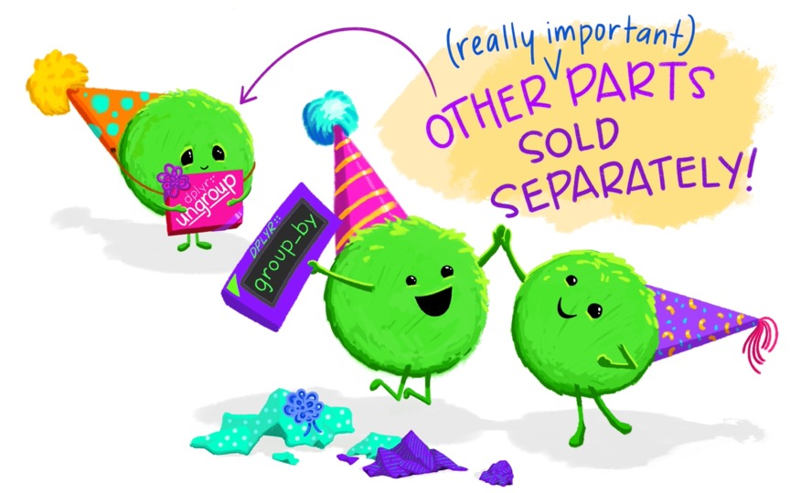

Slide 8
summarize() + group_by()
summarize() will calculate a summary stat for an entire frame. Here we have two in one expression:
But, we often don’t want just one number
gapminder %>% summarize(mean_life = mean(lifeExp), min_life = min(lifeExp))
## # A tibble: 1 x 2
## mean_life min_life
## <dbl> <dbl>
## 1 59.5 23.6

Slide 9
summarize() + group_by()
group_by() will create groups based on the expressions listed.
But, they are invisible!
gapminder %>% group_by(continent)
## # A tibble: 1,704 x 6
## # Groups: continent [5]
## country continent year lifeExp pop gdpPercap
## <fct> <fct> <int> <dbl> <int> <dbl>
## 1 Afghanistan Asia 1952 28.8 8425333 779.
## 2 Afghanistan Asia 1957 30.3 9240934 821.
## 3 Afghanistan Asia 1962 32.0 10267083 853.
## 4 Afghanistan Asia 1967 34.0 11537966 836.
## 5 Afghanistan Asia 1972 36.1 13079460 740.
## 6 Afghanistan Asia 1977 38.4 14880372 786.
## 7 Afghanistan Asia 1982 39.9 12881816 978.
## 8 Afghanistan Asia 1987 40.8 13867957 852.
← We grouped across 5 continents, but the data itself is unchanged

Slide 10
summarize() + group_by()
Now, combine group_by() with summarize()
gapminder %>%
group_by(continent) %>%
summarize(n_countries = n_distinct(country),
avg_life_exp = mean(lifeExp))
## # A tibble: 5 x 3
## continent n_countries avg_life_exp
## <fct> <int> <dbl>
## 1 Africa 52 48.9
## 2 Americas 25 64.7
## 3 Asia 33 60.1
## 4 Europe 30 71.9
## 5 Oceania 2 74.3
<-- ooh! We could plot this!

Slide 12
ungroup()
Why would I ever want to undo my hard work?
gapminder %>%
group_by(country) %>%
mutate(mn = pop/mean(pop)) %>%
ungroup()
## # A tibble: 5 x 3
## continent n_countries avg_life_exp
## <fct> <int> <dbl>
## 1 Africa 52 48.9
## 2 Americas 25 64.7
## 3 Asia 33 60.1
## 4 Europe 30 71.9
## 5 Oceania 2 74.3
<-- ooh! We could plot this!

Slide 13
{ggplot2} scales!

Slide 14
Scales: a one-line wonder
General pattern
scale_AESTHETIC_DETAILS()
scale_x_continuous() scale_y_reverse() scale_color_viridis_c() scale_shape_manual(values = c(19, 13, 15)) scale_fill_manual(values = c("red", "orange", "blue"))

Slide 15
Colors
Using manual, you can feed the scale specific colors
R standard colors: white, black, chartreuse4, etc.
Hex codes: #32a2a8
scale_fill_manual(values = c("chartreuse4", "cornsilk4", "black", "#fc03b6", "#5c47d6"))

Slide 16
{ggplot2} themes!

Slide 17
Contrast
Repetition
Alignment
Proximity

Slide 18
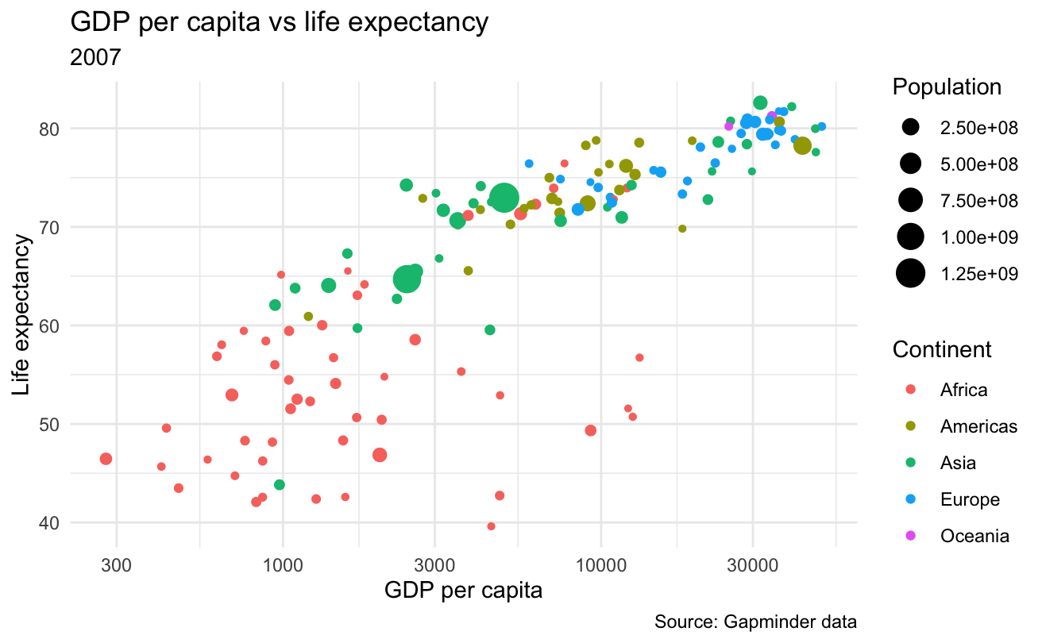
Eight built-in themes
Default: theme_gray()
theme_minimal()
https://henrywang.nl/ggplot2-theme-elements-demonstration/
Easy

Slide 19
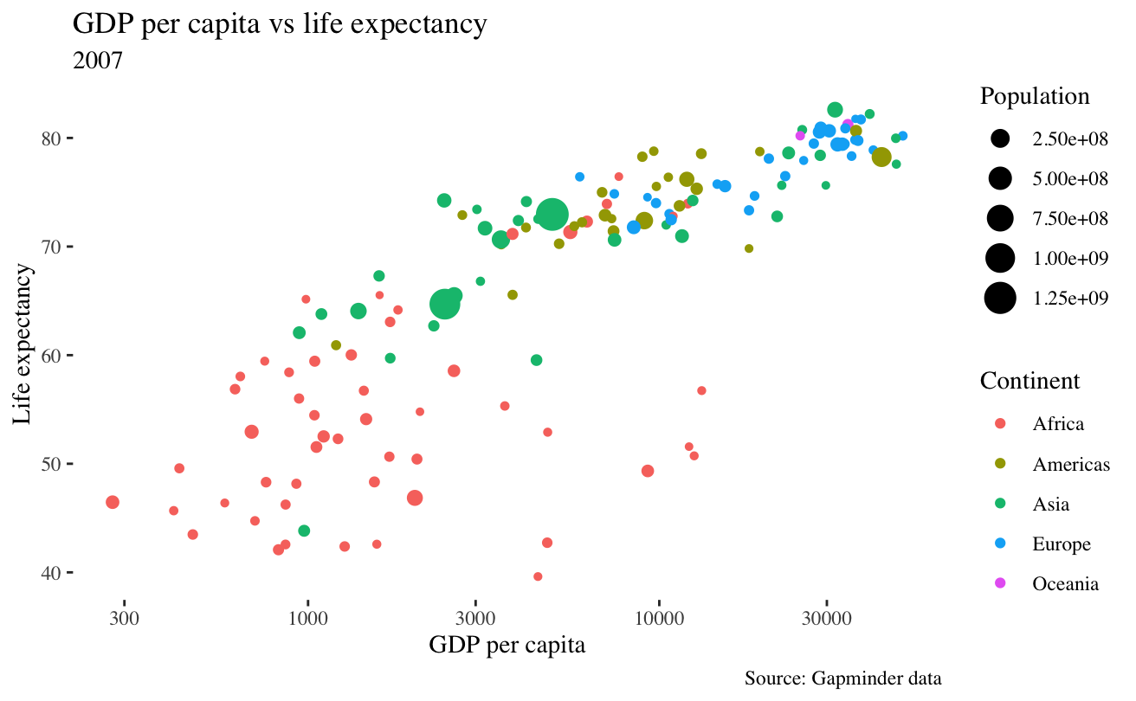
ggthemes()
library(ggthemes)
gdplifeplot + theme_tufte()
Easy

Slide 20
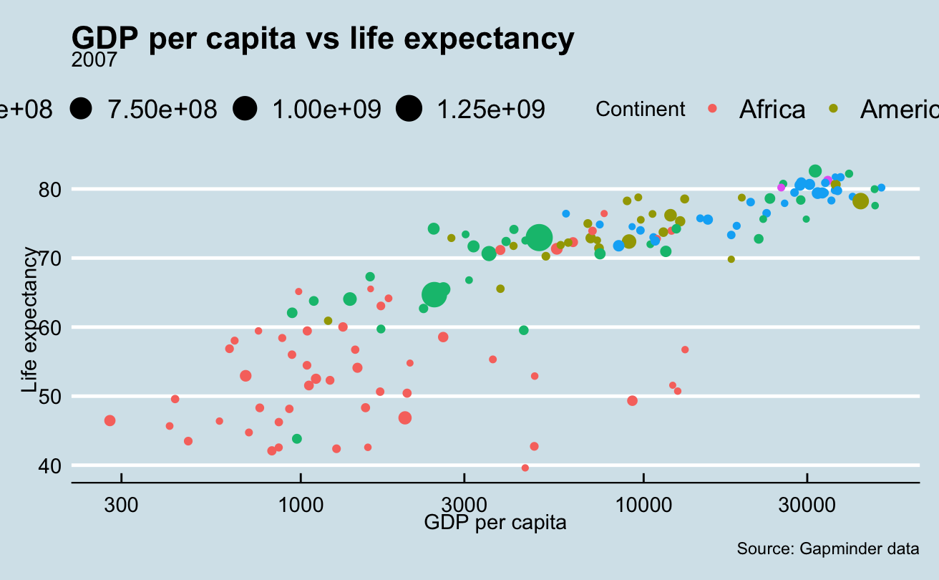
ggthemes()
library(ggthemes)
gdplifeplot + theme_economist()
Easy

Slide 21
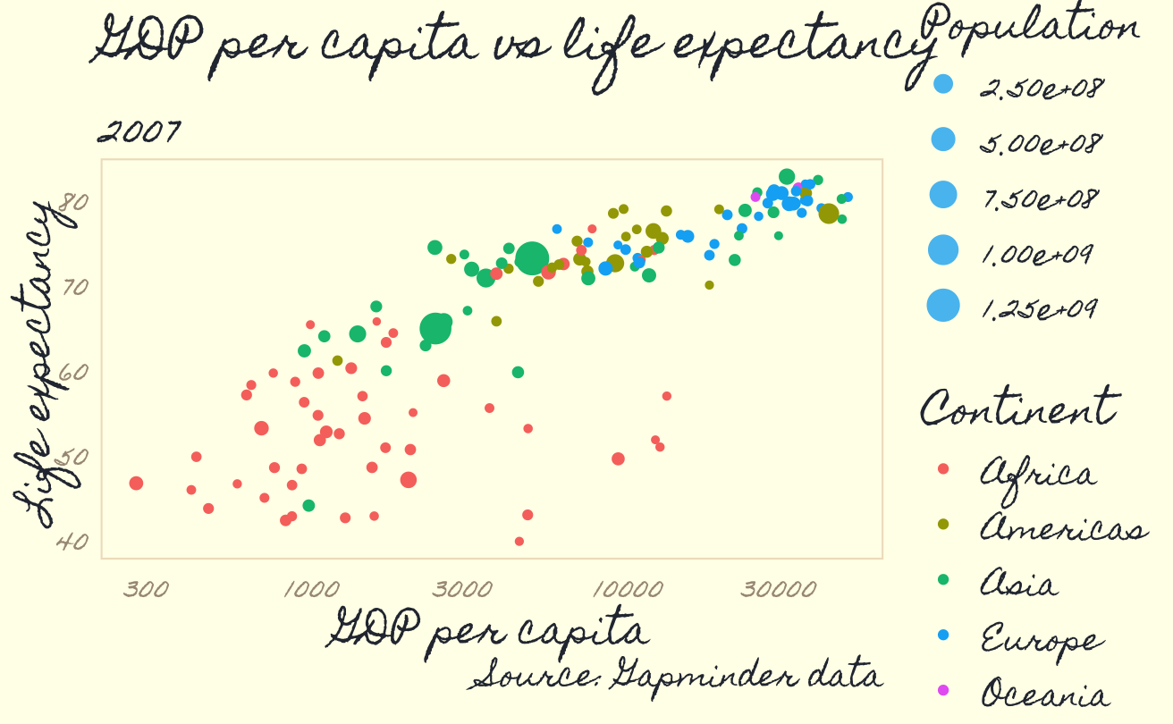
If you are feeling brave …
# Fancy way to install package
install.packages("devtools")
devtools::install_github("gadenbuie/ggpomological")
# Manually dl Homemade Apple font
library(ggpomological)
gdplifeplot +
theme_pomological_fancy()
Harder

Slide 22
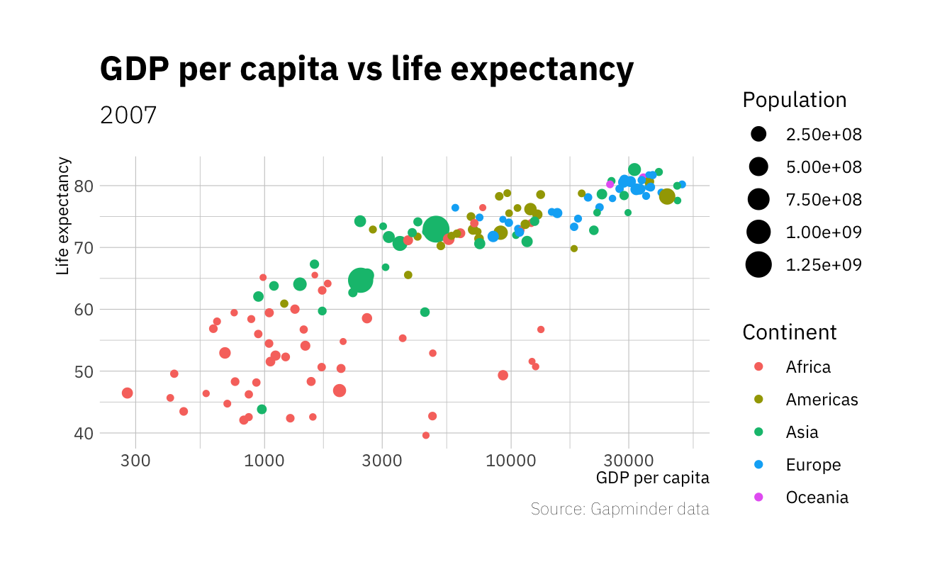
If you are feeling brave …
# Install packages
install.packages("hrbrthemes")
library(hrbrthemes)
## Another one where you need to install fonts
gdplifeplot +
theme_ipsum_ps()
Harder

Slide 23
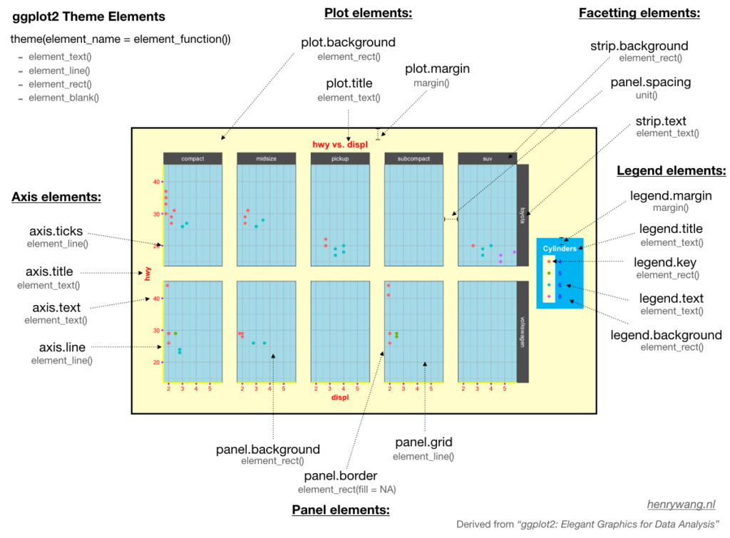
Harder

Slide 24
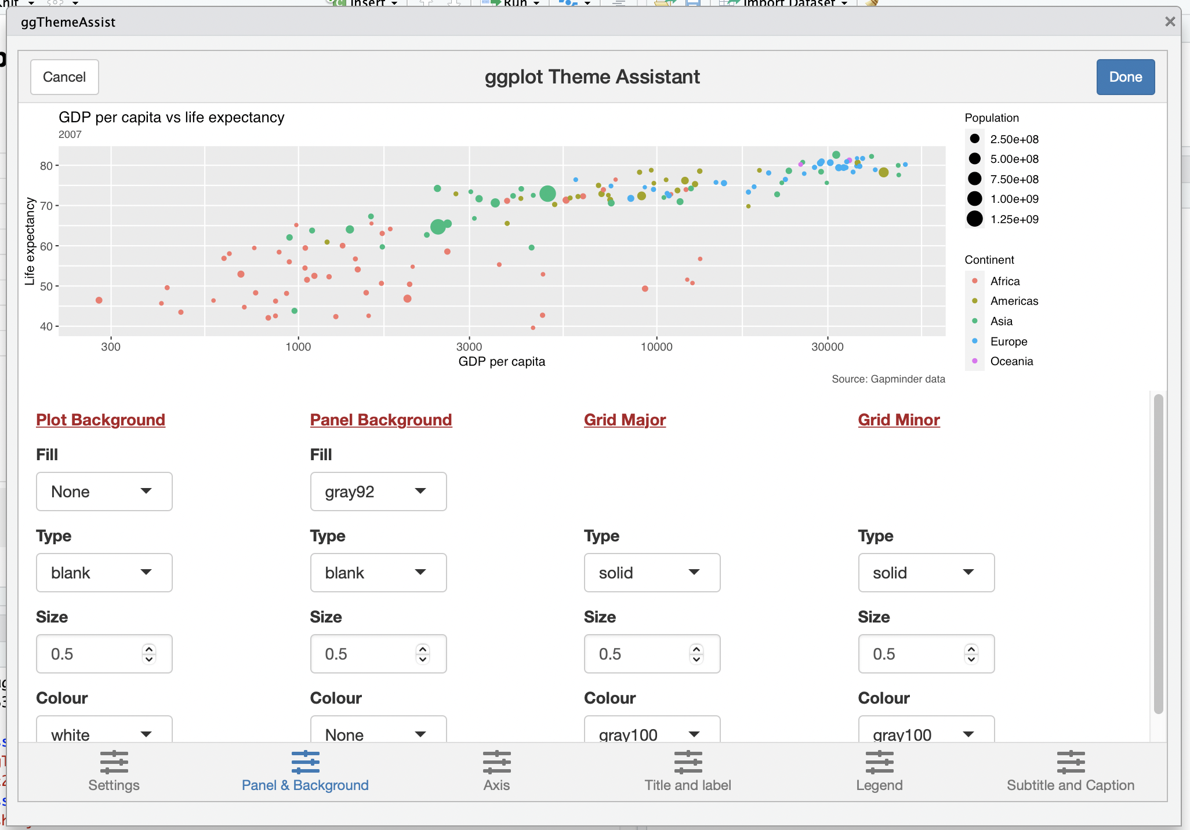
This takes some practice
A recommendation:
Until you build more comfort, use ggThemeAssist()
It will output code for you!
Medium

Slide 25
Saving your plots with ggsave()
Save your plot as an object
Export that object to a file using ggsave()
Select file type
Select file size
gdplifeplot <- gapminder %>%
filter(year == "2007") %>%
ggplot(mapping = aes(x = gdpPercap, y = lifeExp, color = continent, size = pop)) +
geom_point() +
scale_x_log10()
ggsave(filename = "gdplifeplot.png", plot = gdplifeplot, width = 6, height = 4.5, units = "in")

Slide 26
Importing data

Slide 27
Where does data come from?
A package with data frames
library(gapminder)
A csv or Excel file
data2 <- read_csv("data.csv")
Uses readr package, part of tidyverse
data2 <- read_excel("data") <- can handle .xls & .xlsx files
Uses readxl package, part of tidyverse
Lots of options to help with cleanup!
Another source like github
devtools::install_github("mikeasilva/blsAPI")
Easy
Medium
Harder

Slide 28
Where to find cool, new stuff
When packages are hosted on repositories like CRAN, we can use our standard command
When packages are hosted elsewhere, we use devtools() to install them
The double colon tells R to look for the command in the devtools library , without even loading it!
install.packages(“ggThemeAssist”)
# install.packages("devtools")
devtools::install_github("ahmedmoustafa/evergreen")

Slide 31
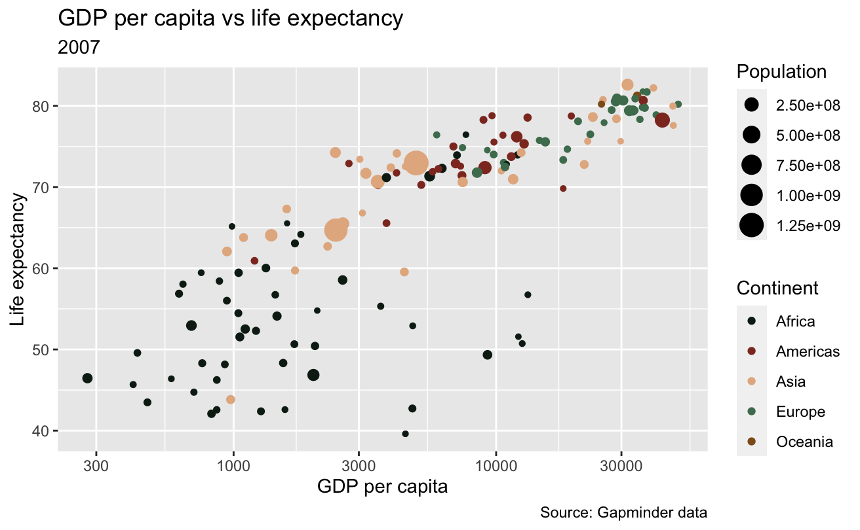
library(evergreen)
gdplifeplot +
scale_color_manual(values = evergreen())

